Slide 1
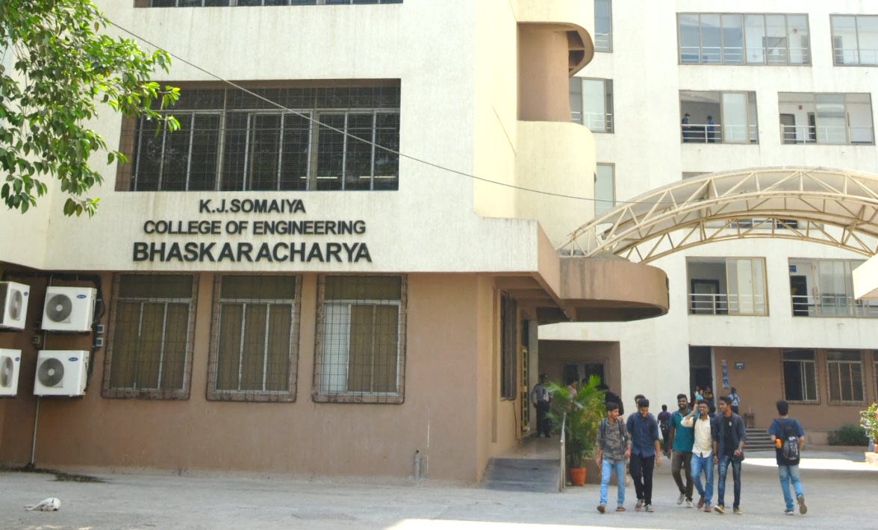
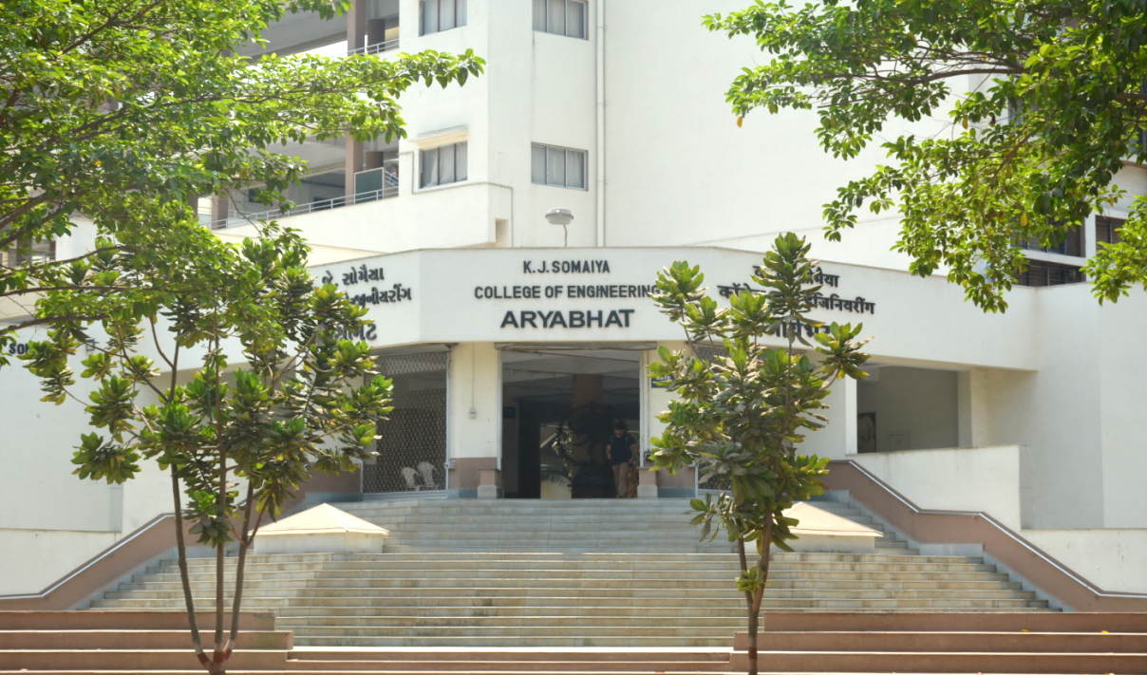
K J Somaiya College of Engineering, Mumbai-77
(Constituent college of Somaiya Vidyavihar University)
Title: Student Attendance Management System Using Data Structures
Presented by: 16010123012- Aaryan Sharma
16010123017- Aditey Kshirsagar
16010123023- Aditya Baheti

Slide 2
Problem Definition
Problem Statement: Managing student attendance is essential but can be tedious and time-consuming when done manually. A system is needed to maintain and track attendance accurately, allowing users to mark attendance, view attendance summaries and undo recent changes to correct errors efficiently.
Objective: The objective of this system is to develop a digital solution that allows efficient tracking and management of student attendance. This system aims to simplify attendance marking, reduce errors, enable undo actions and provide a clear summary of each student's attendance record.
Features:
Add Students: Easily add new students.
Mark Attendance: Mark attendance for specific days or for a continuous range of days.
Undo Attendance Changes: Correct mistakes with a stack-based undo feature.
View Summary: Display attendance records in summary.

Slide 3
Appropriateness of Chosen Data Structure
The chosen Data Structures are Array and Stack-
Array of Students: Direct Access: Arrays allow for direct access to elements via indexing.
Fixed Size: The number of students and days are predetermined, making arrays a good choice since they efficiently handle fixed-size data.
Simple: Arrays they keep the program efficient in both memory and performance. Since each Student structure includes an array for attendance, it's easy to iterate over days and determine attendance summaries.
Stack for Undo: LIFO Behavior: The Last-In-First-Out (LIFO) nature of a stack makes it ideal for undo operations.
Undo Recent Changes: Stacks allow quick and efficient undo operations in constant time O(1) without the need for searching or sorting, as they reverse recent actions instantly due to their LIFO nature.
Minimal Memory: Using a stack to store only recent changes keeps memory usage low.
IDE used Visual Studio Code

Slide 4
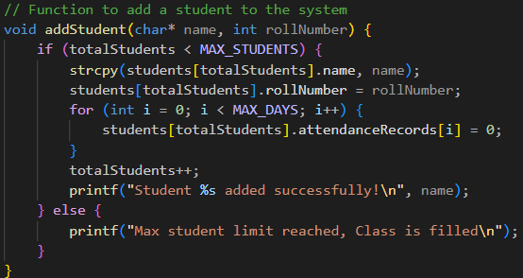
Implementation Details

Slide 5
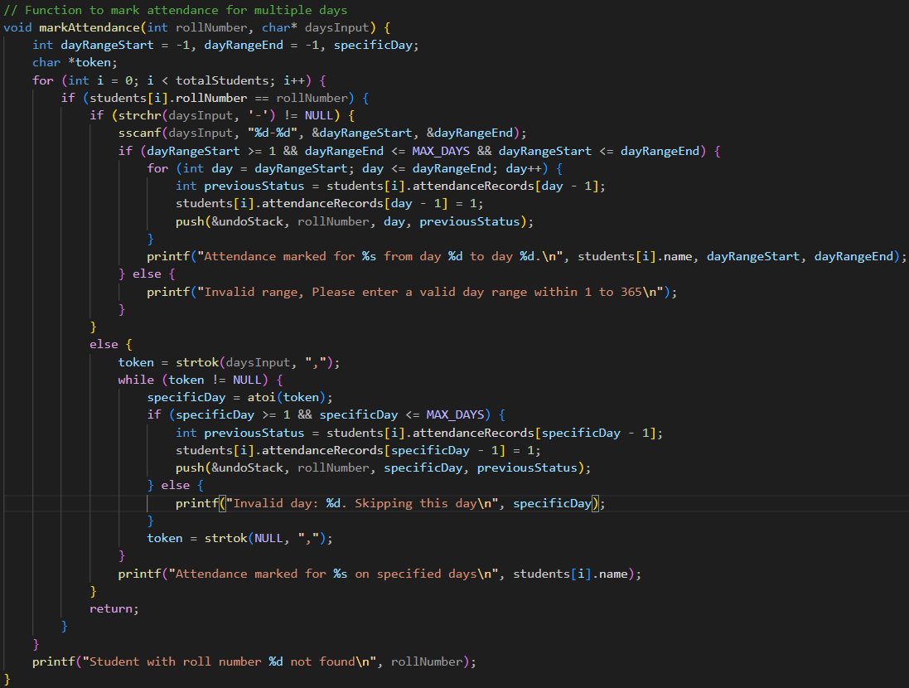
Implementation Details

Slide 6
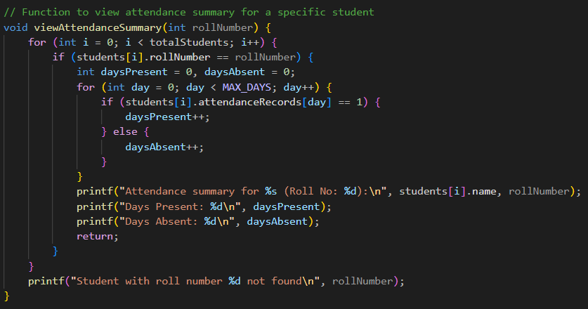
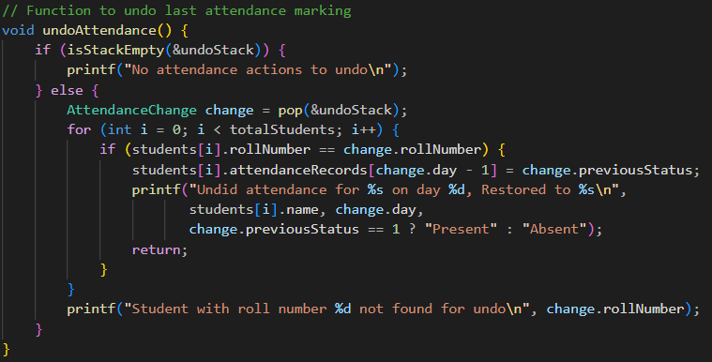
Implementation Details

Slide 7
Test Cases Considered
Valid Inputs:
Attendance for specific days (e.g., Day 1, Day 10) and a range (e.g., Day 5-15), accepts ranges and comma-separated days for flexible attendance marking.
Undo changes sequentially and observe stack behavior.
Invalid Inputs:
Days outside 1-365 range.
Exceeding maximum students.
Invalid data for undo when the stack is empty.
Error Handling:
Error messages for invalid roll numbers or out-of-range days.
Stack full and empty conditions are well-handled.

Slide 8
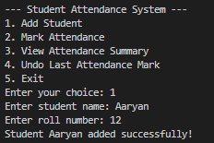
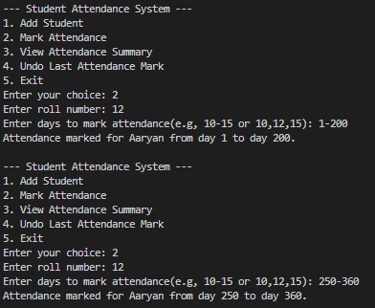
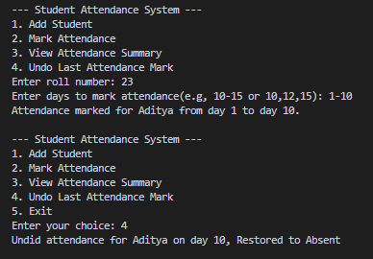
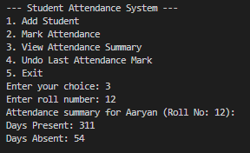
Test Cases Considered
Functionality:

Slide 9
Result Analysis
Accurate Attendance Tracking
Successfully managed student attendance for up to a full academic year.
Demonstrated accurate day-by-day attendance marking, handling both specific days and day ranges.
Undo Functionality Validation
The stack-based undo feature performed reliably, allowing quick correction of recent attendance changes.
Demonstrated accurate day-by-day attendance marking, handling both specific days and day ranges.
Performance:
Effective for up to 100 students.
Optimal use of stack operations for rapid undo actions.

Slide 10
CONCLUSION
The Student Attendance Management System demonstrates a practical and efficient application of data structures, specifically leveraging stacks for its undo functionality. By integrating a stack, the system efficiently addresses real-world requirements for error correction, allowing swift reversal of recent actions. This feature enhances the accuracy and usability of attendance tracking, reducing manual errors. With a user-friendly interface, comprehensive input handling, and clear explanations of the process, this project provides a solid foundation for further advancements, such as additional student information, multi-day marking capabilities, and mobile platform compatibility.

Slide 11
THANK YOU

